Slide 1
Rescue Tracking System
Group Members:
Charmi Ashokbhai Patel (0893156)
Nishi Bhaveshkumar Patel (0883744)
Rinkal Ashishbhai Mehta (0884199)

Slide 2
Introduction
We are proposing a system where the patients, along with the hospital can track the ambulance whenever called for emergencies.
This real-time ambulance tracking system is using the Global Positioning System (GPS) technology to receive the live location of the ambulance which is being called.

Slide 3
Problem Statement
The traditional and the existing ambulance management system is using the printed maps.
In this method, the hospital administration person has the printed maps of the whole city or the district in which that particular hospital is located.
The latitudes and longitudes of this map are plotted on the X-Y coordinates of a graph.
The patient/the end-users have to manually find out the locations on these maps using the X-Y coordinates.
But this traditional method of ambulance tracking using the printed maps is very time consuming. Therefore it is ineffective, as the printed maps are inefficient to show the detailed map/high-level map.

Slide 4
Goals
To provide transparency between patients and the hospital management, when the ambulance is being sent by the hospital control room to the seriously ill patients in the case of emergencies, the mobile communication system that we are developing would improve the speed and accuracy of ambulance/rescue squad tracing.
This would ultimately help in saving lives by transmitting the patient’s medical information from the ambulance to the emergency medical center.

Slide 5
Methodology
There are two tracking methods. They all use active devices. They are:
Automatic Vehicle Location system
Assisted Global Positioning System
In this method, we use advance tracking and ambulance monitoring system via GPS technology using Google Maps API. It consists of Android software to receive real-time location via GPS receiver on the ambulance driver’s Android smartphone.

Slide 6
Tools and Technology
Tools used are Android Studio and IntelliJ IDEA.
The back end used in our project is SQLite and front end used is XML.
The official language for Android development is Java.
We will follow the Prototyping model for developing this Project and whole Project will be developed using the SDLC scenario.

Slide 7
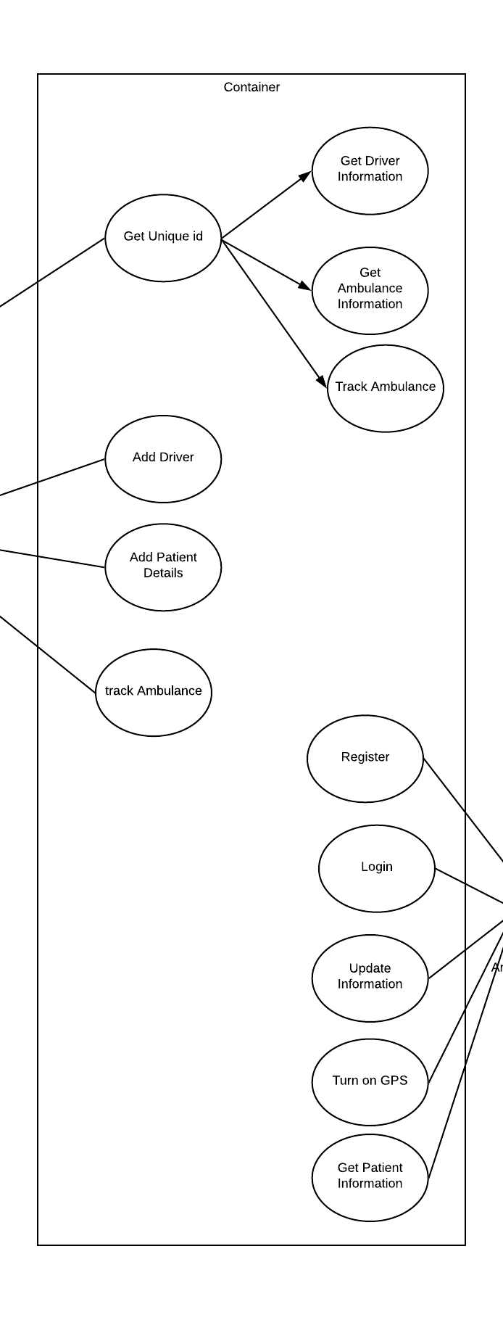
Use case Diagram

Slide 8
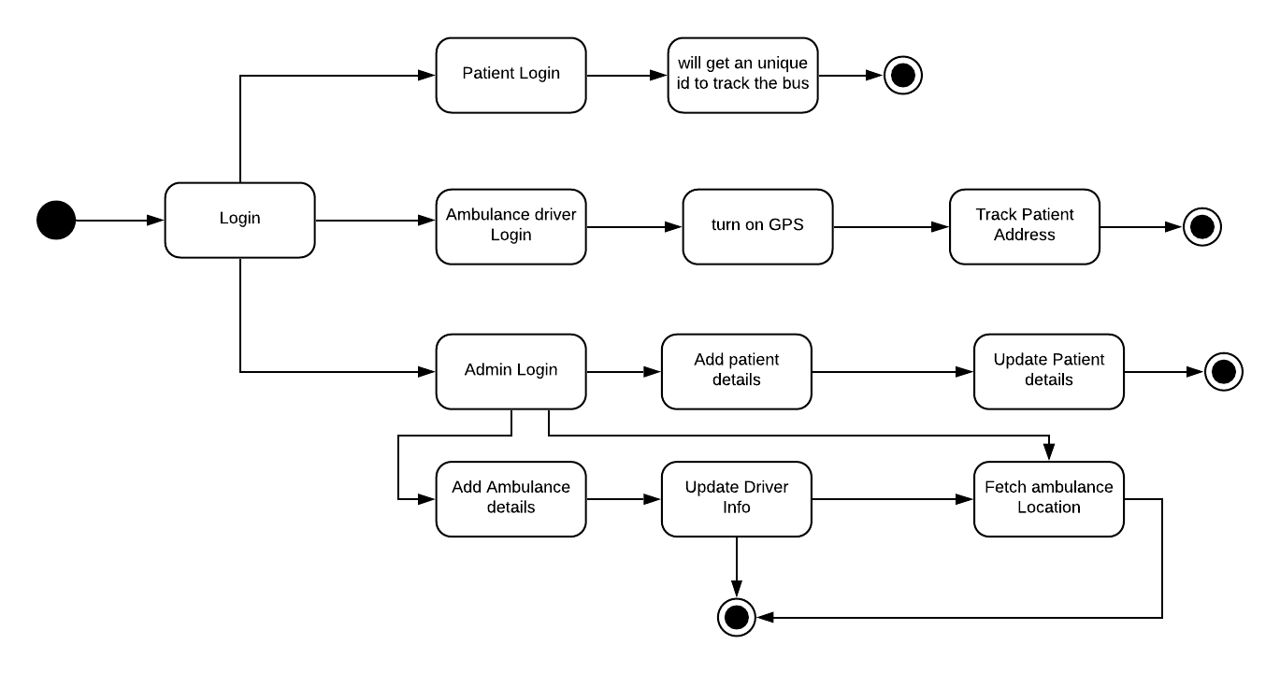
State Diagram

Slide 9
Screen Snapshots of the application

Slide 10
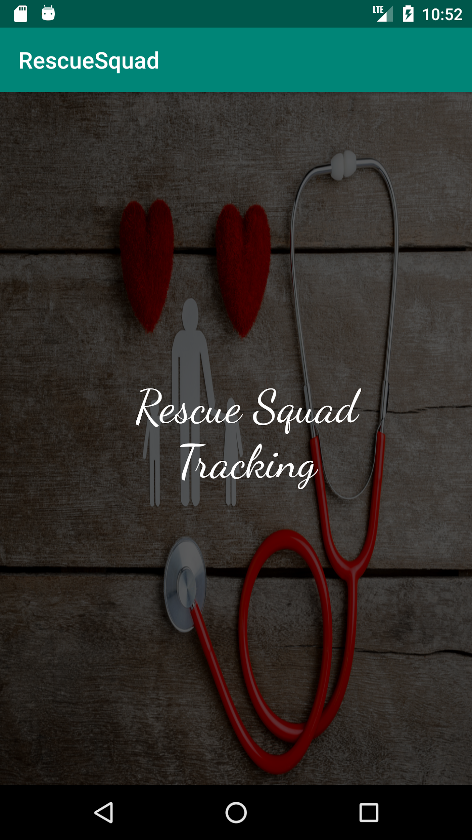

Slide 11
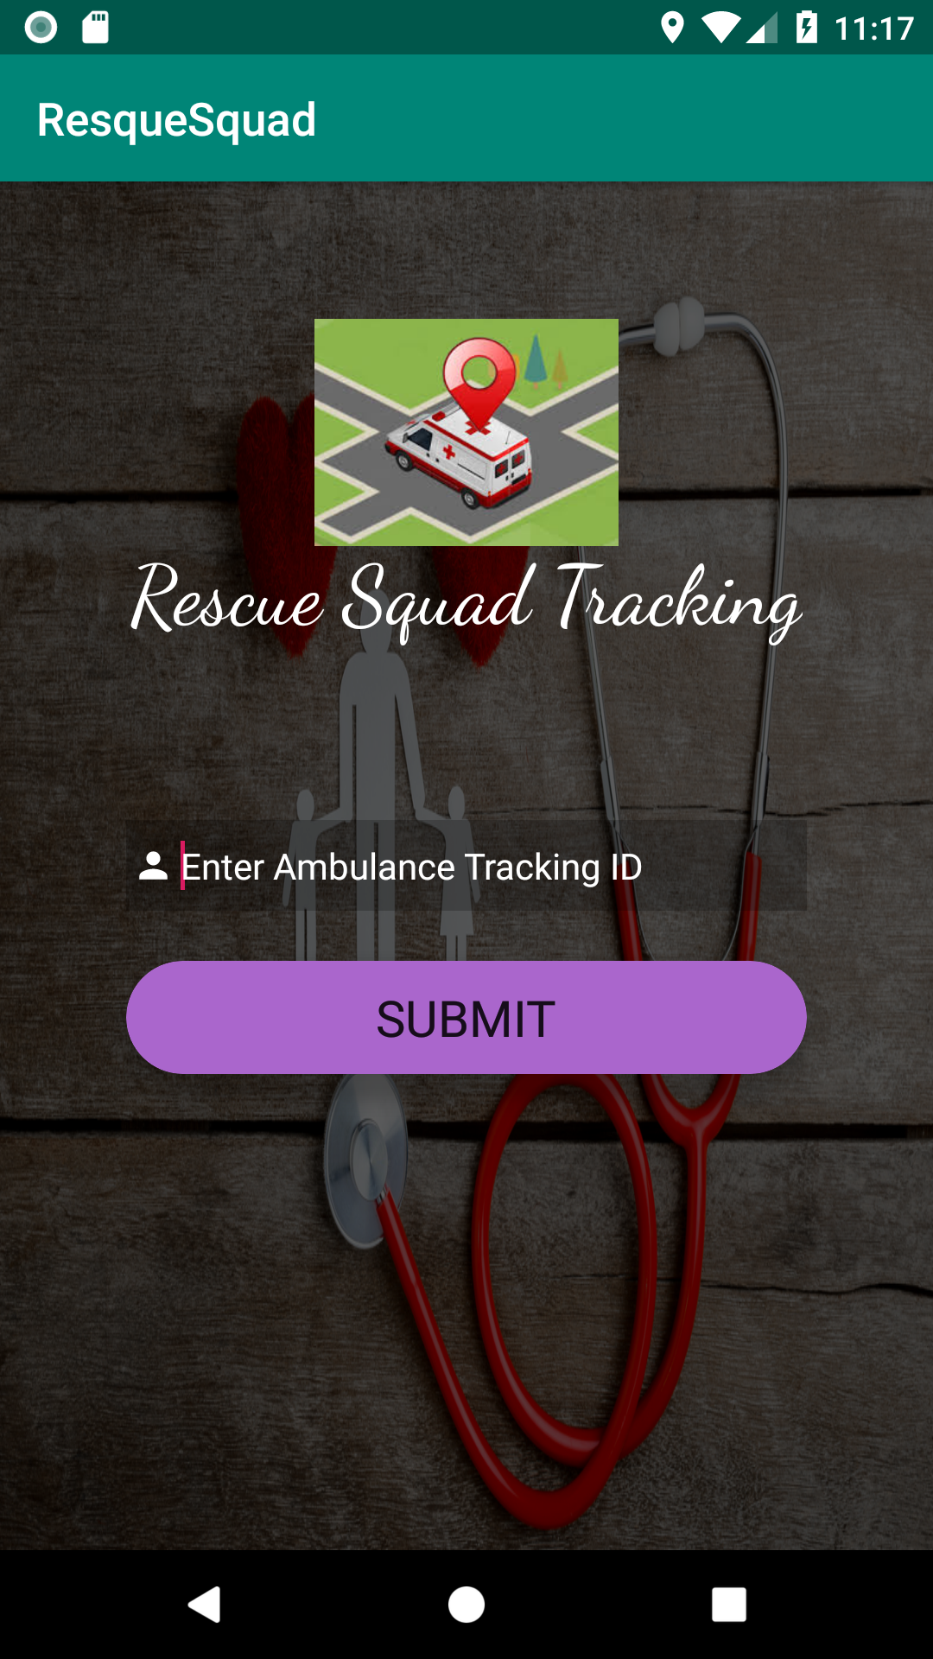

Slide 12
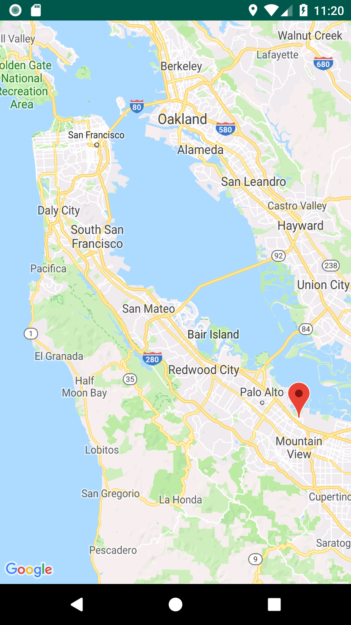

Slide 13
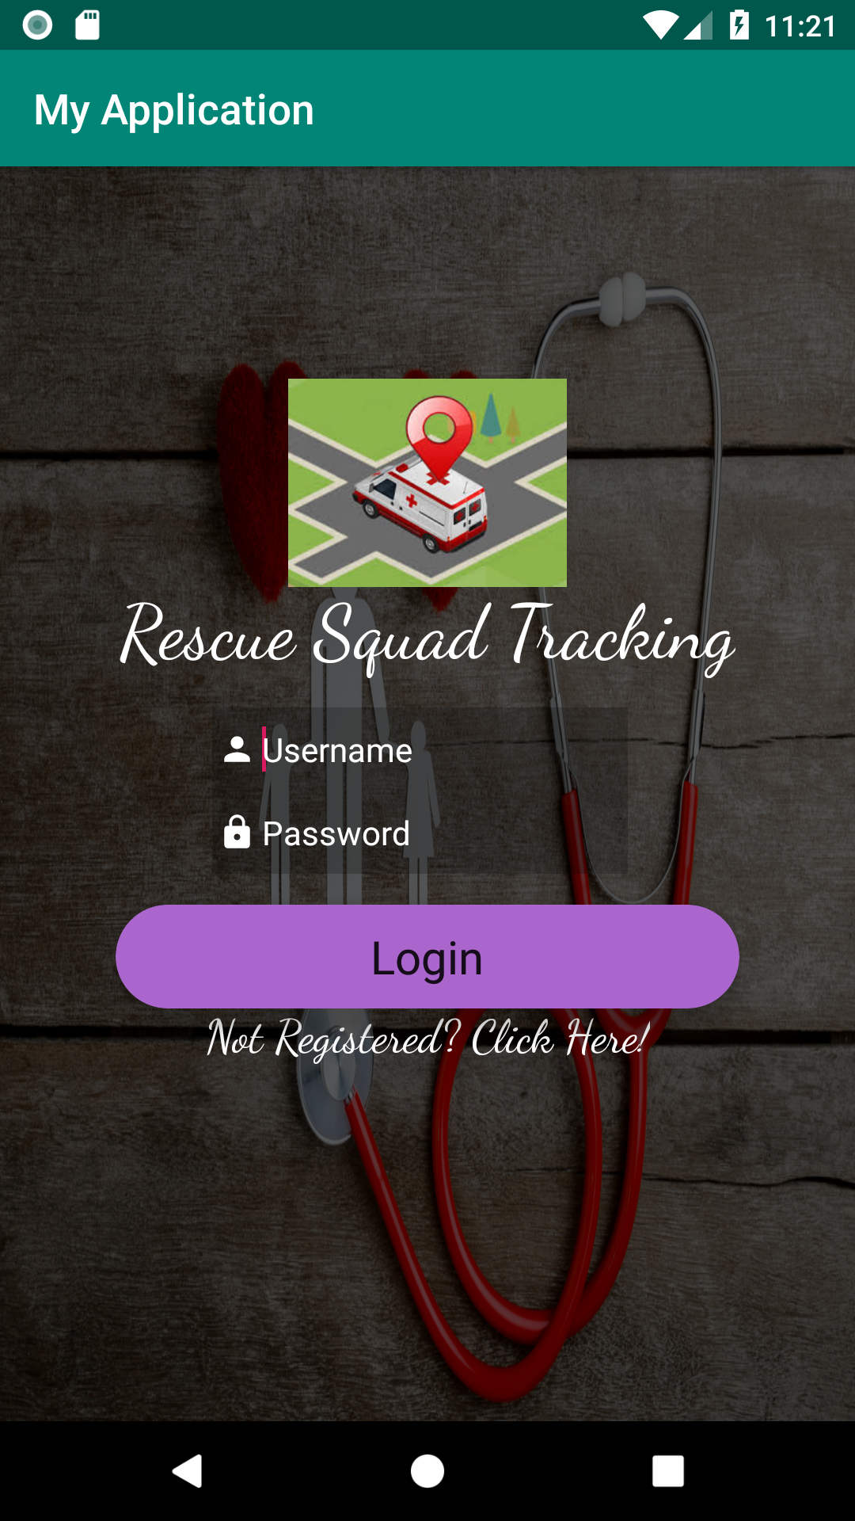

Slide 14
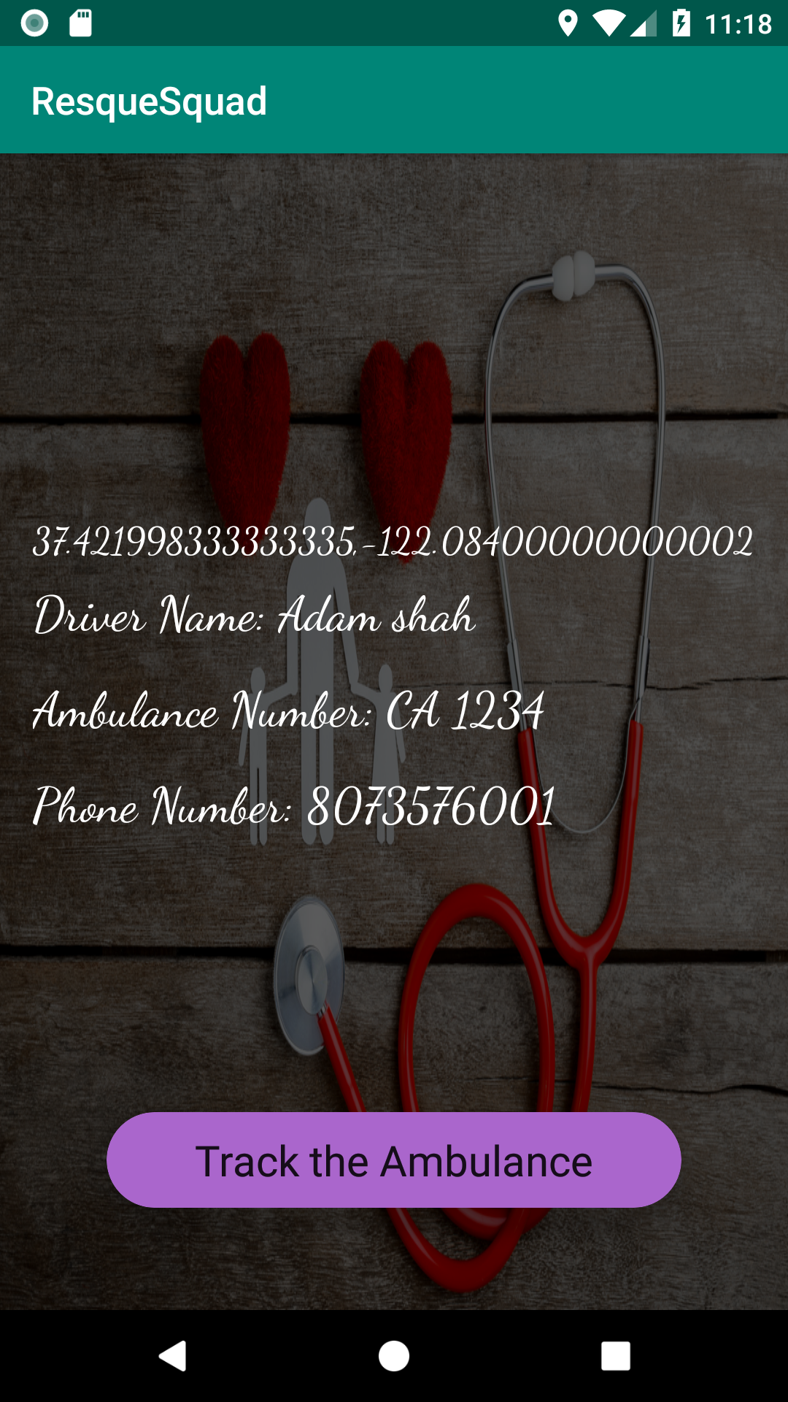

Slide 15
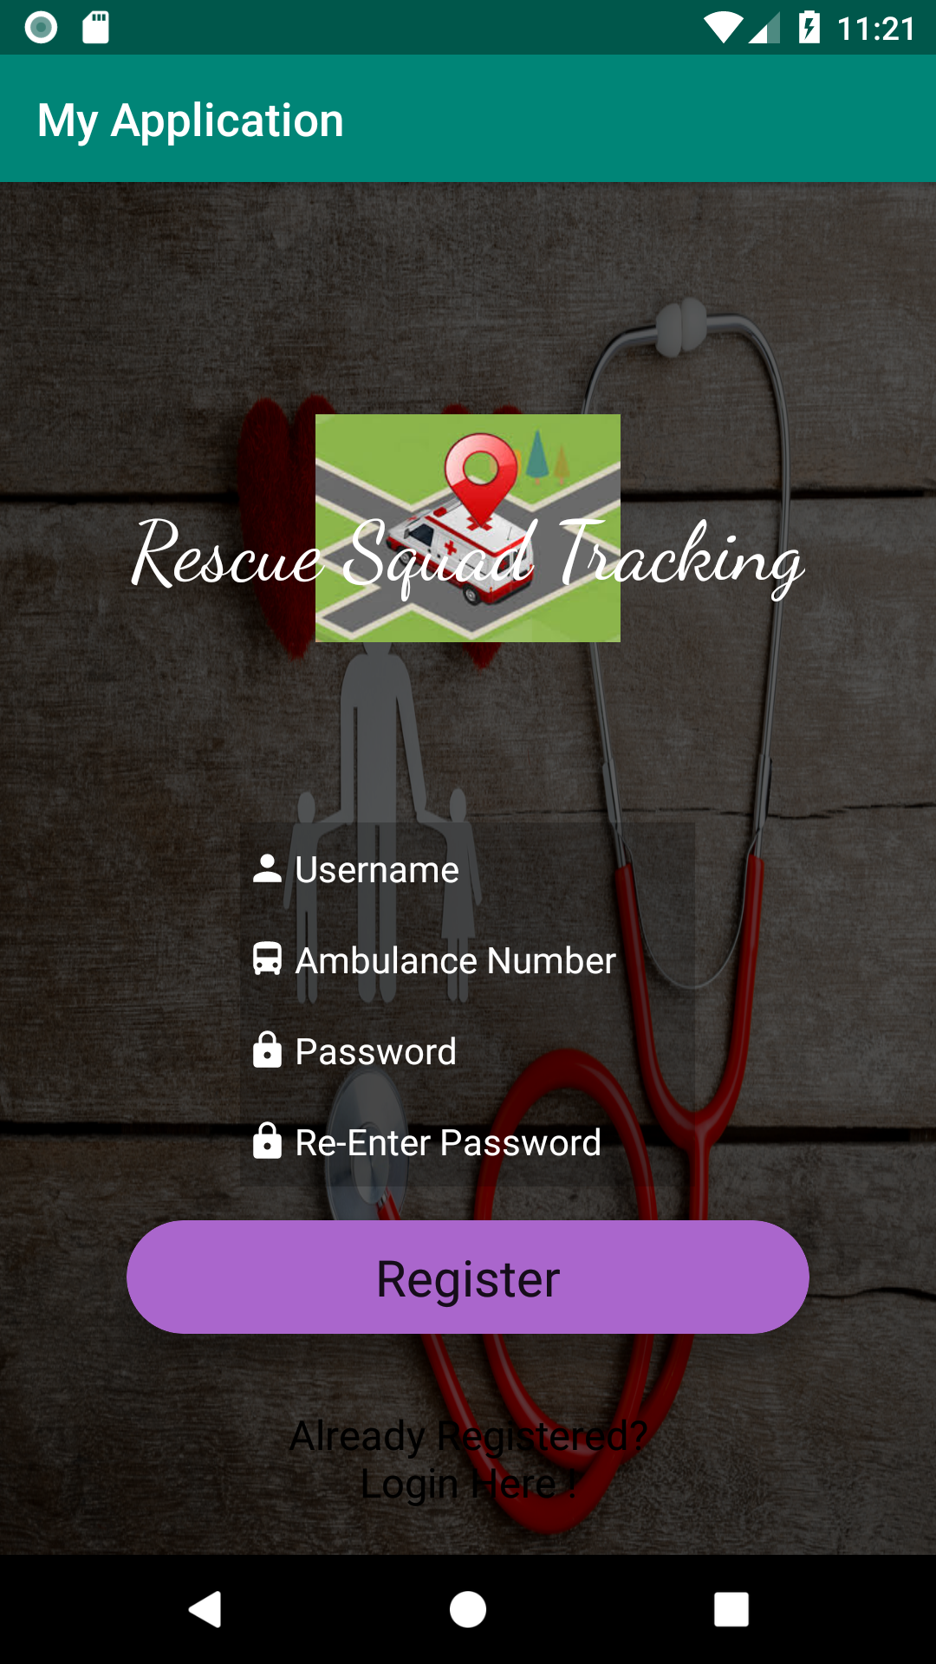

Slide 16
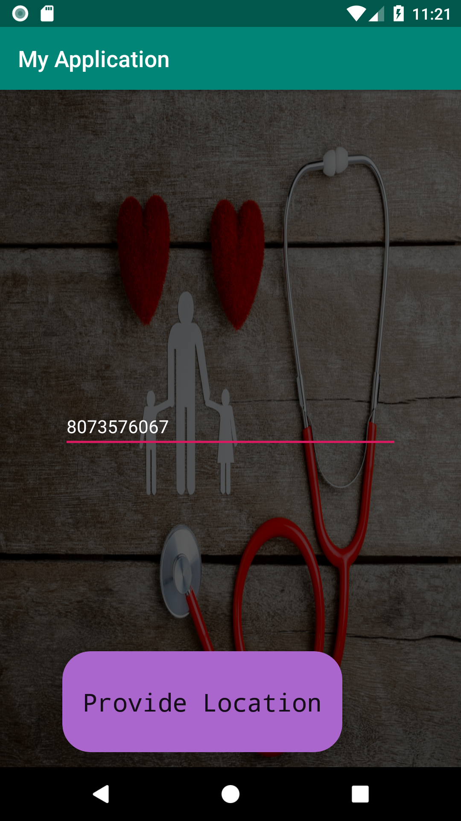

Slide 17
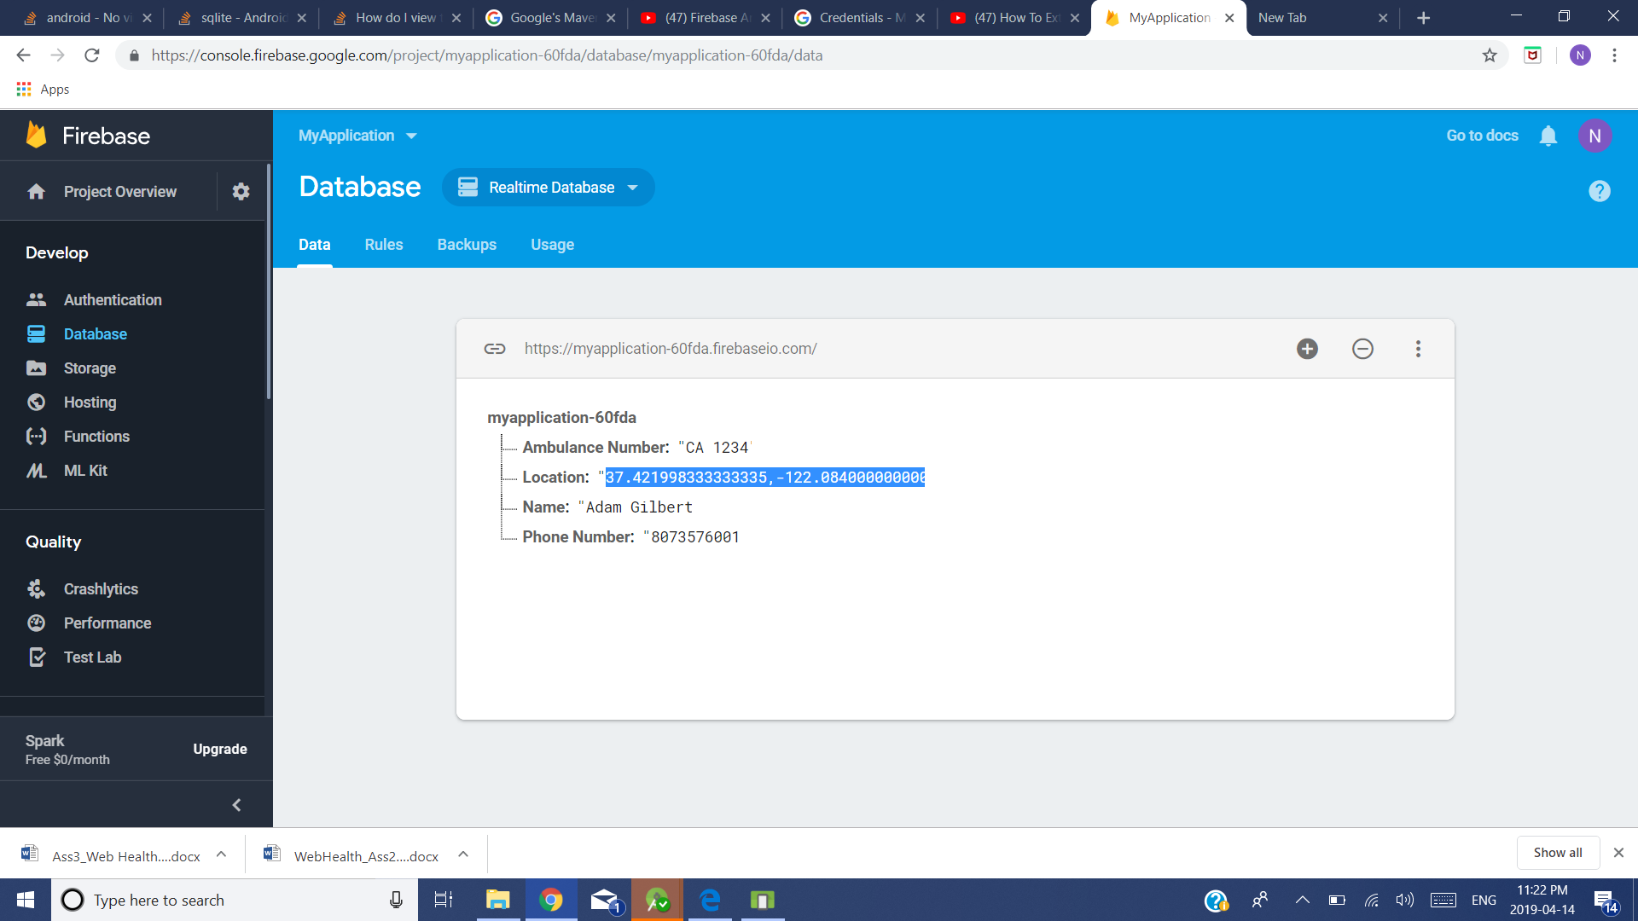

Slide 18
Future Work
We are planning to upgrade our application by adding additional features like sending the current situation of patient’s health to the doctor, so that they can prepare themself to treat the patient at the earliest.
We would also work on transmitting the location information taken from GPS satellites and various information collected from vehicles and other similar informations to a center through GSM/GPRS, which would then be provided to users through the medium of internet.

Slide 19
Conclusion
Our application is a real-time ambulance tracking system which uses a global positioning system (GPS) technology, which receive the location of the ambulance, send a unique ID to the patient/their relatives via message on their smartphone. They will thereafter connect internet by a general packet radio service (GPRS) technology for displaying a real time on the website map developed by Google Map. The application is developed in Android Technology for designing .With the Google Map on a real-time website, ambulance can be monitored and located very effectively. This includes paths and/or ambulance directions.

Slide 20
Project Repository Link
The link to our project repository on GitHub is given as follows:
https://github.com/RescueSquad/RST-Project

Slide 21
References
https://www.researchgate.net
https://www.tutorialspoint.com

